Slide 1
The Best Return on Your Investments
Matthew 6:19-24
Dr. Rick Griffith, Crossroads International Church Singapore
www.BibleStudyDownloads.org

Slide 2
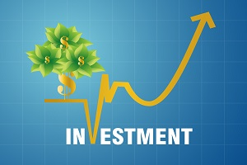
Everyone is looking for the best investments.
Notes:
Everyone is looking for the best investments, right?

Slide 3
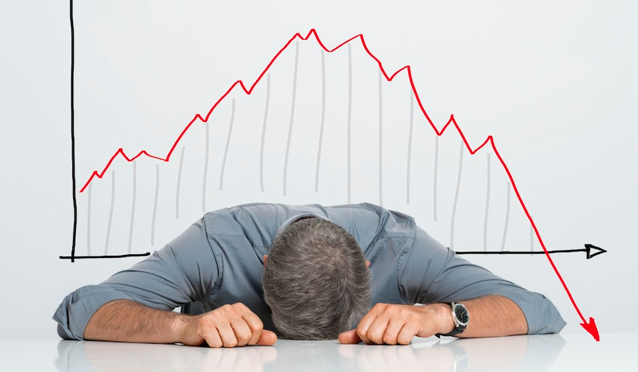
Who wants to invest their money in things that will fail?

Slide 4
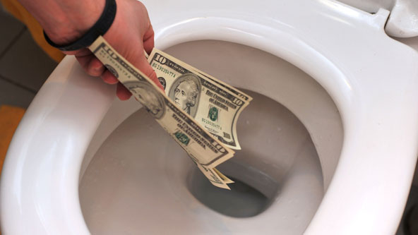
Your Choice
Notes:
If I gave you a choice of two investments—
• one that will be totally lost and
• the other that will bring dividends beyond your wildest dreams, which would you pick?
Well, today I am going to give you exactly these choices.
How many of you would you like me to explain an investment strategy where all you earn will be destroyed?
Who would like me to tell you where to invest your money so that the returns are more than you can imagine?

Slide 5
Investments: Earthly or Heavenly
Notes:
Most people spend their money on earthly—not heavenly—things. This leads to total loss while investing in heaven brings great gain.

Slide 6
Why should you invest in heaven?

Slide 7
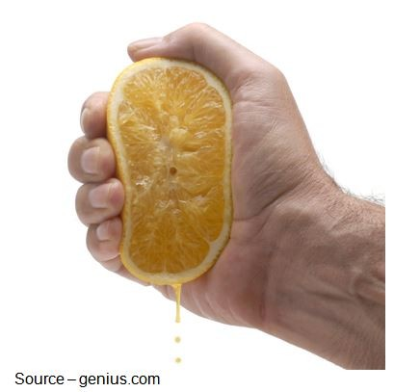
My Goal: To Squeeze Everything I Can Out of You at Church?
Notes:
Now if you aren't accustomed to going to church, you may be thinking, "Yep, I knew it. Another pastor talking about money again. Undoubtedly he does this every week!"

Slide 8
The Sermon on the Mount (Matthew 5–7)
Notes:
Actually, I am just going through what Jesus said in his Sermon on the Mount.

Slide 9
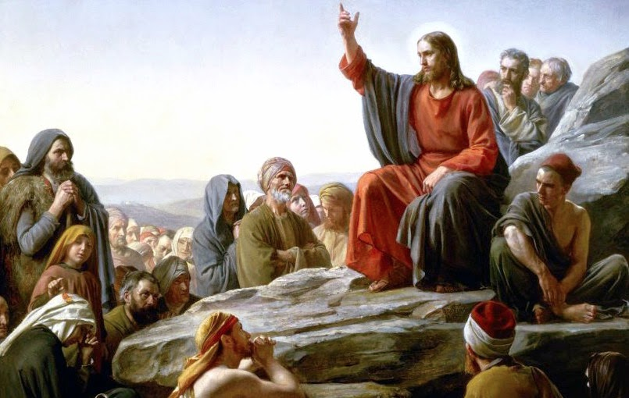
"Rabbi" Jesus
Notes:
This is the most famous sermon ever preached…

Slide 10
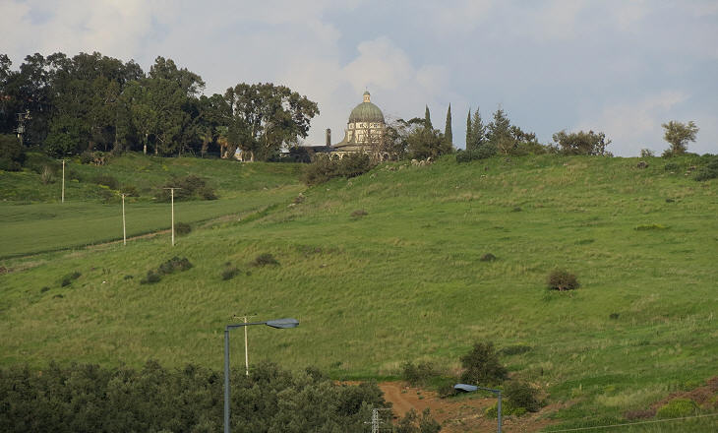
Mount of Beatitudes
Notes:
when Jesus spoke on what we call the Mount of Beatitudes

Slide 11
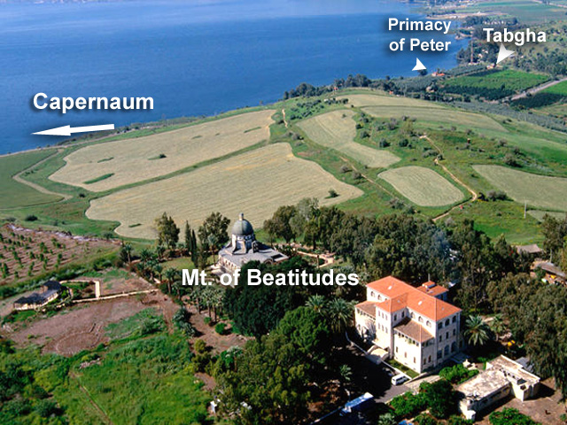
Mount of Beatitudes
Peter's House
Synagogue
Sea of Galilee
Notes:
…overlooking the Sea of Galilee.

Slide 12
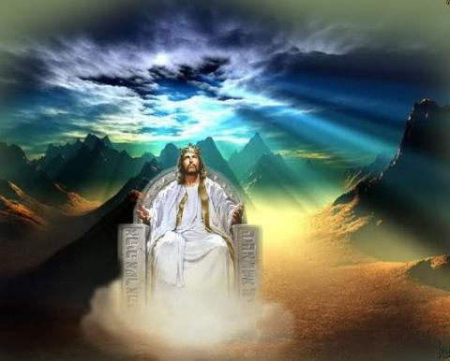
When Jesus is King… (Matthew 5–7)
What would your life look like if Christ was truly the boss of your life?
Notes:
But what did Jesus say? Well, it's taking us 20 weeks to see! Basically he details what life looks like when Jesus is King in our lives.

Slide 13
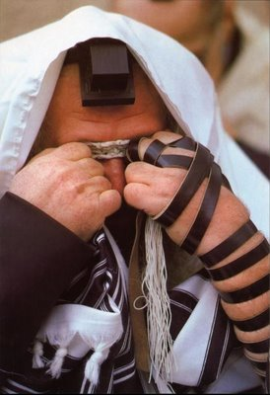
The Sermon on the Mount
Pharisee Teaching (Matthew 5)
Pharisee Practice (Matthew 6)
Notes:
Before today’s text, Jesus has already contrasted his teaching to the teaching of the Pharisees in Matthew 5, showing that true righteousness is shown in acknowledging Christ as King—not in following the religious teacher’s emphasis on external traditions
• In Matthew 6, Jesus turns his attention from the teaching to the practice of the Pharisees.

Slide 14
Parallel Structure
GIVING (1-4)
PRAYER (5-15)
FASTING (16-18)
Hypocrites (2)
Hypocrites (5)
Hypocrites (16)
Public show (1-2)
Public show (5)
Public show (16)
Human Reward (2)
Human Reward (5)
Human Reward (16)
Secret (4)
Secret (6)
Secret (18)
Father sees (4)
Father sees (6, 8)
Father sees (18)
Notes:
The basic idea is that people reward public disciplines like giving, prayer and fasting because man thinks highly of those committed to such practices. However, God rewards those who show that Jesus is King in their private giving, prayer and fasting.
What kind of reward do we get for giving, prayer and fasting? That depends on whom we try to please with such spiritual disciplines!
_________
Barbieri notes, "In all three examples of Pharisaic 'righteousness'—almsgiving (vv. 1-4), praying (vv. 5-15), and fasting (vv. 16-18)—Jesus spoke of hypocrites (vv. 2, 5, 16), public ostentation (vv. 1-2, 5, 16), receiving their reward in full when their actions are done before men (vv. 2, 5, 16), acting in secret (vv. 4, 6, 18), and being rewarded by the Father, who sees or 'knows,' when one's actions are done secretly (vv. 4, 6, 8, 18)" (Barbieri, BKC, 2:33).

Slide 15
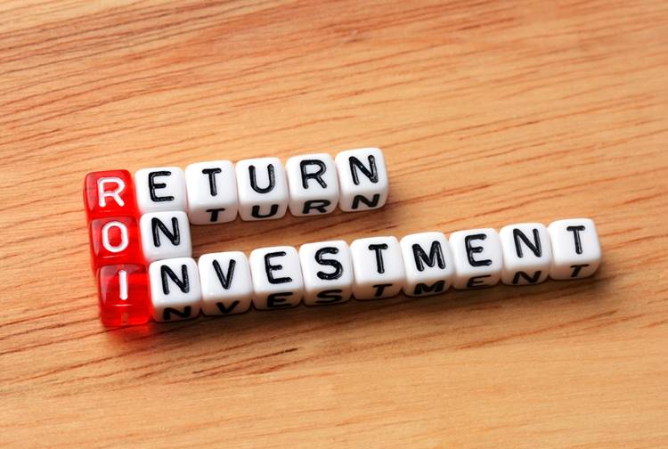
Investments
Notes:
The same idea of rewards applies to the ROI, or Return on Investment of our money. Using our money for God receives his eternal heavenly reward, but using it only for things in life receives a temporary reward only on earth.

Slide 16
Why should you invest in heaven?
3 reasons
Matthew 6:19-24
Notes:
Today let's see three reasons to invest in heaven.
• Matthew 6:19-24 answers why we should invest money for God rather than spend money on ourselves.
So what's the first reason you should invest in heaven?

Slide 17
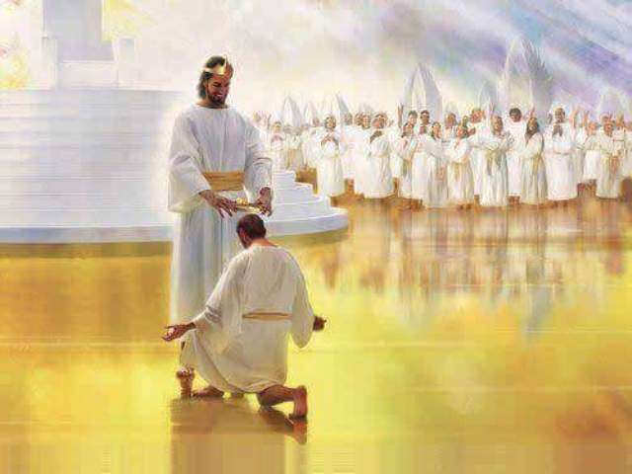
I. Pursuing eternal reward makes sense (6:19-21).
Notes:
Investments that last are better than those that are lost.

Slide 18
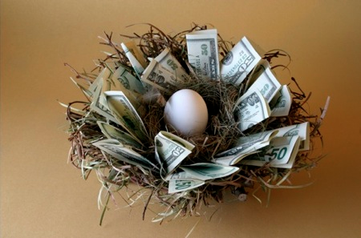
"Do not store up for yourselves treasures on earth, where moth and rust destroy, and where thieves break in and steal" (6:19 NIV).
Notes:
Collect heavenly—not earthly—rewards since they're eternal (6:19-20).
What does it mean to "store up for yourself treasures on earth" (6:19a)?

Slide 19
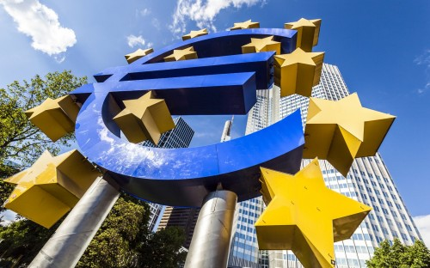
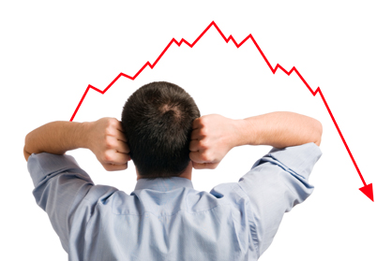
Investing
Notes:
We are all making investments every day. No one is "doing nothing" with their life! Everyone is doing something with his or her life.
The question is not if we investing our life. The question is what are we investing our life in?

Slide 20
"Do not store up for yourselves treasures on earth, where moth and rust destroy, and where thieves break in and steal" (6:19 NIV).
Notes:
What is the common trait of moths, rust and thieves (6:19b)?

Slide 21
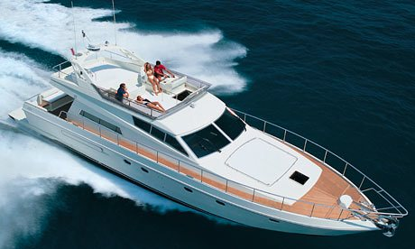
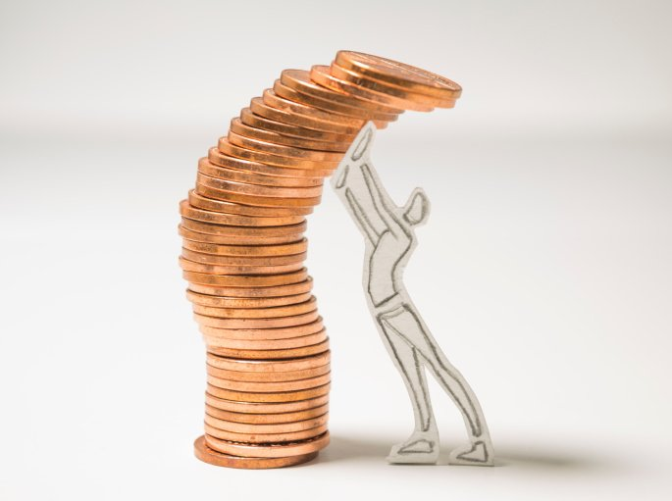
Earthly things don't last.
Notes:
All three show us that we can spend our money on stuff that won't even last for this life—let alone with eternity!

Slide 22
What is eternal?
God
God's Word
Souls of People
Notes:
Only three things will outlast this life—God (love), God’s Word, and people.

Slide 23
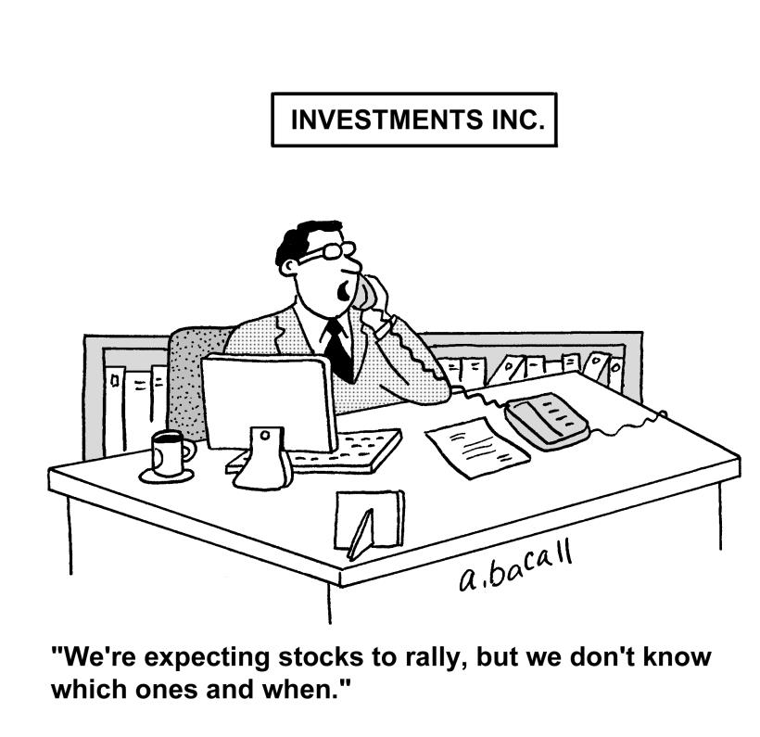
INVESTMENTS, INC.
"We're expecting stocks to rally, but we don't know which ones and when."
Notes:
In contrast, it’s like the broker who says, “We’re expecting stocks to rally, but we don’t know which ones and when.”

Slide 24
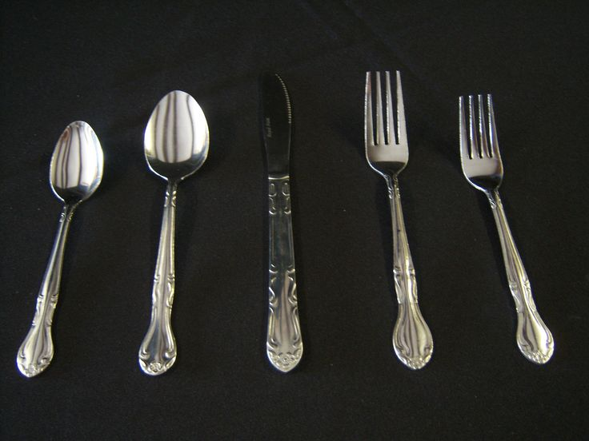
Silverware can be stolen.
Notes:
I know a lady has a valuable set of silverware. The thought of anyone breaking into her house when she is on holiday scares her, so she takes it with her on vacation and keeps it under the car seat. Her actions are consistent with what she values.

Slide 25
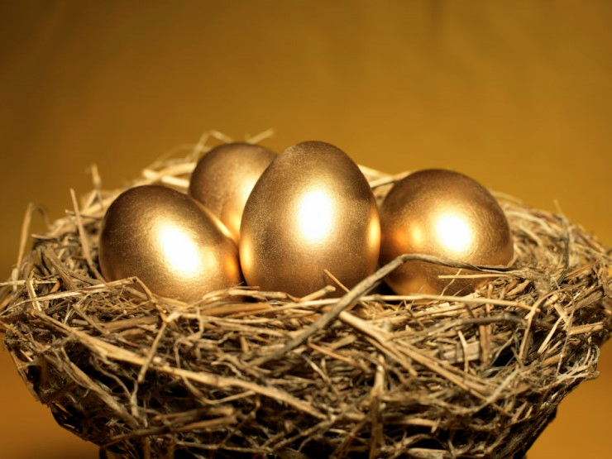
"But store up for yourselves treasures in heaven, where moth and rust do not destroy, and where thieves do not break in and steal" (6:20 NIV).
Notes:
Does the reference to heavenly treasures mean we won’t all have the same heavenly reward (6:20)?
The fact that Jesus exhorted his disciples towards reward shows that we will not all rewarded the same!

Slide 26
Our faith determines our destination. Our actions determine our eternal rewards.
Notes:
The NT often tells us to invest in our inheritance. Here we must distinguish between our faith in Christ that determines our destination and our actions that determine our eternal rewards.

Slide 27
The Judgment Seat of Christ
Is this a judgment to determine salvation?
Or is it to reward believers?

Slide 28
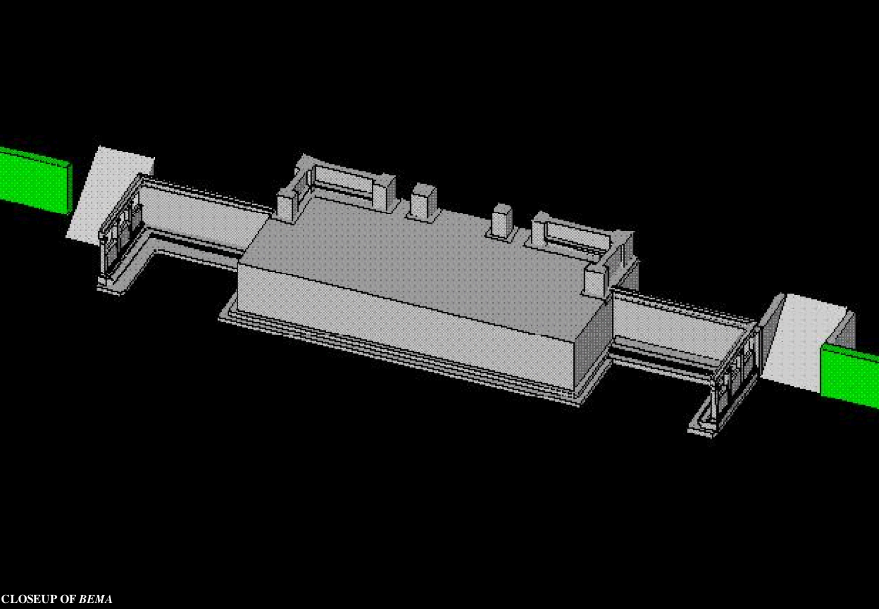
Bema Close-up
"So we make it our goal to please him, whether we are at home in the body or away from it. ¹⁰For we must all appear before the judgment seat [bema] of Christ, that each one may receive what is due him for the things done while in the body, whether good or bad" (2 Cor. 5:9-10 NIV).
Notes:
28
Every one of us will appear before Jesus himself to give an accounting of our life.
http://corinth.sas.upenn.edu/schola.html

Slide 29
"… the fire will test the quality of each man's work" (1 Cor. 3:13)
76
Notes:
29
We see in 1 Corinthians 3 that our deeds are either good and lasting (gold, silver, precious stones) or bad and flammable (wood, hay, straw). The good ones will be rewarded.

Slide 30
Lasting Building Materials (3:12a)
Silver
Gold
Jewels
Foundation: The Lord Jesus Christ (1 Cor. 3:11)
Adapted from Charles R. Swindoll. "Spiritual Gifts Study Guide" (IFL, 1983), 7
Notes:
Every believer is building on the foundation of Christ in his life. Some of us use great building materials—compared to gold, silver, and jewels. These last through the fire that tests them.

Slide 31
Perishable Building Materials (3:12b)
Hay
Wood
Straw
Foundation: The Lord Jesus Christ (1 Cor. 3:11)
Adapted from Charles R. Swindoll. "Spiritual Gifts Study Guide" (IFL, 1983), 7
Notes:
But other Christians spend their lives on temporal building materials like wood, hay, and straw. These are bad deeds or even good works done with the wrong motive.

Slide 32
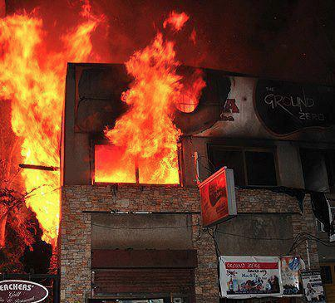
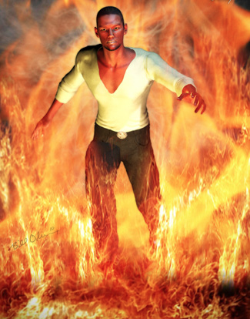
"saved as through fire…" (3:15)
Notes:
A believer who wastes his life still goes to heaven—his life is spared—but all he has worked for in the kingdom is destroyed so that he enters heaven with little but the clothes on his back, so to speak.

Slide 33
Do you invest mostly in heaven or earth?
Notes:
After buying food and clothes, how much of the rest do you spend on yourself?
Do you know the percentage of money you give away?
How much could you send up to heaven after meeting your basic needs?

Slide 34
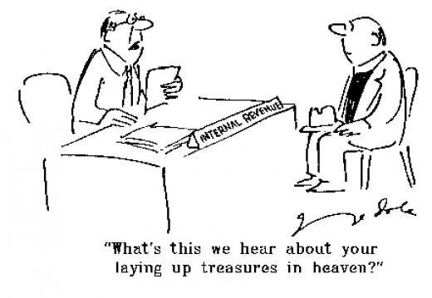
Don't expect people to understand.
"What's this we hear about you laying up treasures in heaven?"
Notes:
Don’t expect people to understand you laying up heavenly treasures.

Slide 35
"For where your treasure is, there your heart will be also" (6:21 NIV).
Notes:
What we value takes our time and energy (6:21).
How are one’s treasure and heart always both in the same place (6:21)?
The old saying goes, “One’s man’s junk is another man’s treasure.”
This simply means that something becomes treasure to us because of the value we put on it.
Unfortunately, the final judge of what is really valuable is neither you nor I. Only God is the Ultimate Judge of value!

Slide 36
Value Management Seminar
Notes:
In April 2016, I attended a two-day Value Management Seminar for SBC.
The idea is that we will all determine what we should value as a college.
Then our next two buildings will be built to reflect those values.

Slide 37
We devote our time and energy to what we value most
Notes:
We devote our time and energy to what we value most.
This weekend our youngest son John is setting up his apartment.
Our caution? Don’t go too fast! Don’t get into debt!

Slide 38
Why should you invest in heaven?
3 reasons
Matthew 6:19-24

Slide 39
I. Pursuing eternal reward makes sense (6:19-21).
Notes:
Investments that last are better than those that are lost.
But what’s the second reason you should invest in heaven?

Slide 40
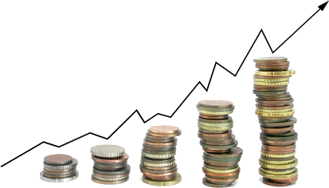
II. Wisdom avoids greed (6:22-23).
Notes:
If you see clearly, you won't have self-indulgence.

Slide 41
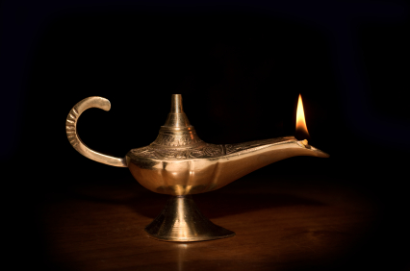
"The eye is the lamp of the body. If your eyes are good, your whole body will be full of light. ²³But if your eyes are bad, your whole body will be full of darkness" (6:22-23a NIV).
Notes:
As a light reveals good priorities, so wisdom prevents greed (6:22-23a).
How is our eye the "lamp” of our body (6:22)? That seems like a mixed metaphor.

Slide 42
"The eye is the lamp of the body…"
Notes:
Your eye determines the kinds of things that will impact you.

Slide 43
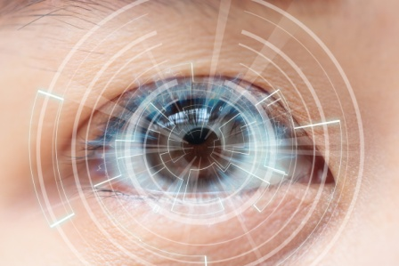
"The eye is the lamp of the body…"
Notes:
In that sense, your eye is the “gatekeeper” to determine your priorities.
The Bible speaks of the “lust of the eyes” in the sense that the eye affects our desires.

Slide 44
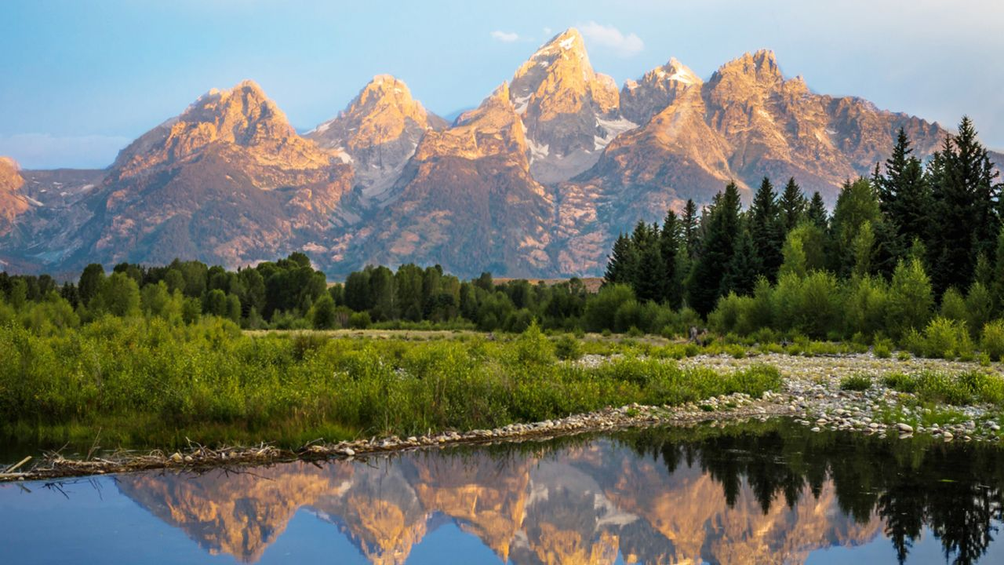
Train your eyes.
Notes:
What examples can we name how a good eye fills the body with light (6:22-23)?
Positively speaking, if your eye sees the beauty of God’s creation, you will be filled with awe and praise of God and your body will move towards the Botanic Gardens!

Slide 45
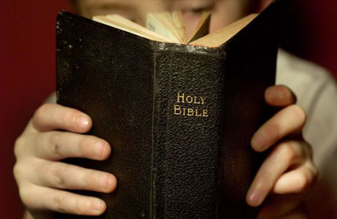
Train your eyes.
Notes:
The same is true of those who regularly read God’s Word—it fills you with light!

Slide 46
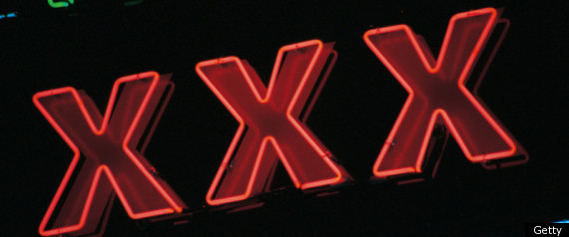
Train your eyes.
Notes:
However, if your eye views pornography as 65% of Christian men in the USA admitted in April 2016, your eye will affect what your body does.

Slide 47
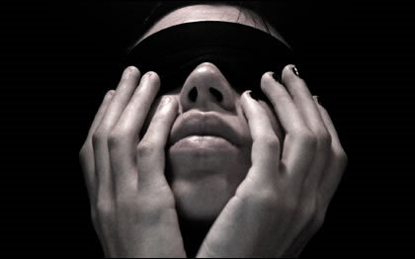
"But if your eyes are bad, your whole body will be full of darkness. If then the light within you is darkness, how great is that darkness!" (6:23 NIV).
Notes:
One who thinks that greed is good is in real trouble (6:23b).

Slide 48
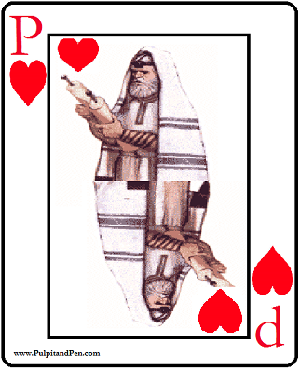
Pharisee Greed
Notes:
The first century Pharisees had the same problem with money that we have today—too often they, like us, saw wealth as a sign of God’s blessing, even though we know that often riches show that our sights are only on earthly things.

Slide 49
"The Pharisees had this problem [of greed] because their spiritual eyes were diseased (Matt. 6:22). With their eyes they were coveting money and wealth. Thus they were in spiritual darkness. They were slaves to the master of greed, and their desire for money was so great they were failing in their service to their true Master, God" (Barbieri, BKC, 2:33)

Slide 50
Why should you invest in heaven?
3 reasons
Matthew 6:19-24

Slide 51
I. Pursuing eternal reward makes sense (6:19-21).
Notes:
Investments that last are better than those that are lost.

Slide 52
II. Wisdom avoids greed (6:22-23).
Notes:
If you see clearly, you won't have self-indulgence.
Now what’s the third reason you should invest in heaven?

Slide 53
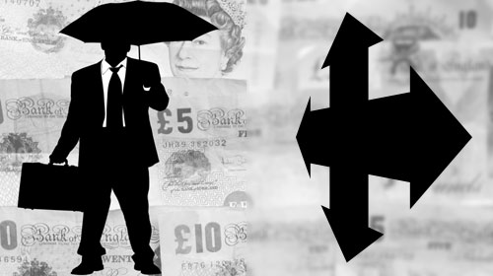
III. Either God or money controls you (6:24).
Notes:
Both Jesus and wealth can’t be priority.

Slide 54
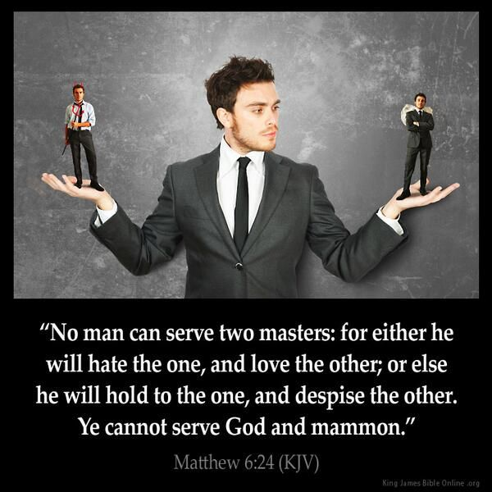
"No one can serve two masters. Either he will hate the one and love the other, or he will be devoted to the one and despise the other. You cannot serve both God and Money" (6:24 NIV).
Notes:
You can commit to only one authority (6:24a).
What is the most valuable item that you own? That is the thing that will occupy your time.
Note that Jesus did not say that we are the master of two things—nor did he say that we are the servant of two things.
What Jesus said is that we are the slave of one master. Every one of us is a slave. The question is not whether we are a slave or a master. We are all slaves—but who is our master? Each of us has only one master—is it God or money?

Slide 55
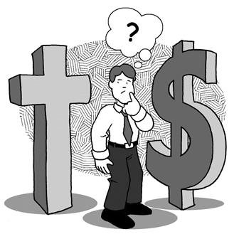
God or Money?
Notes:
You can’t serve both God and money (6:24b).
Why can’t people serve both God and money (6:24)? Shouldn't we all seek “the balanced life”? Why must we love and hate different priorities? Why can’t we love them both equally?

Slide 56
God or Money?
Notes:
When we speak of a priority, we are talking about that which is most important.
Sometimes people say, “I know what I should do. I just need to follow my priority!”
That’s rubbish. We all follow our priority! That’s what makes it our priority!
What we really need is to change what we consider priority!

Slide 57
Why should you invest in heaven?
3 reasons
Matthew 6:19-24
Notes:
So back to our original question: why should you invest in heaven? Instead of three answers, can I just sum up what Jesus said in a single sentence? I’ll try…

Slide 58
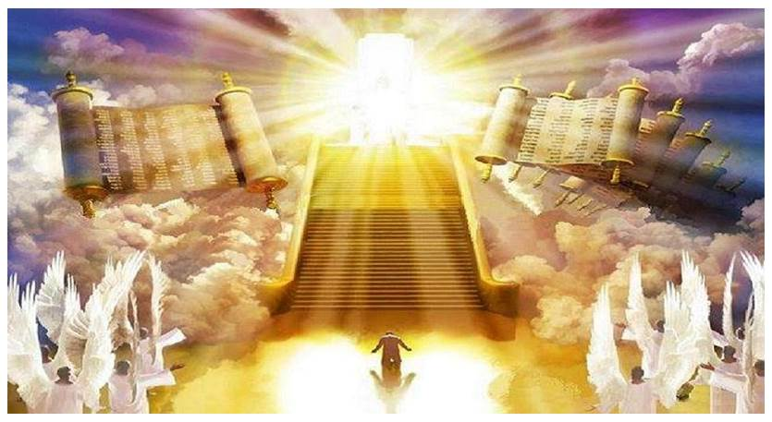
Eternal reward is better than greed.
Main Idea
Notes:
Our priority should heavenly treasures instead of earthly treasures where we spend money only on ourselves.

Slide 59
I. Pursuing eternal reward makes sense (6:19-21).
Notes:
Investments that last are better than those that are lost.

Slide 60
II. Wisdom avoids greed (6:22-23).
Notes:
If you see clearly, you won't have self-indulgence.

Slide 61
III. Either God or money controls you (6:24).
Notes:
Both Jesus and wealth can’t be priority.

Slide 62
Mirrors lie. They don’t show you what’s inside.
Notes:
Mirrors all lie because they don’t show you what’s inside. Are you willing to look inside yourself?

Slide 63
How can you improve your investment priorities?

Slide 64
Invest your time.
Notes:
Invest your time—shown in your schedule.
Who have you not made time for in this assembly?
Take the initiative to take that person to lunch this week.

Slide 65
Invest your talents.
Notes:
Invest your talents—shown in your service.
What ability do you have that you are holding back from using for the Lord?
Surely you can count money. Maybe God is calling you to become our next treasurer.
Surely you can shake people’s hands at the door. Maybe God is telling you to be a greeter.
Surely you can pray with us before the service. Maybe God is telling you to join us at 3:30 for prayer.

Slide 66
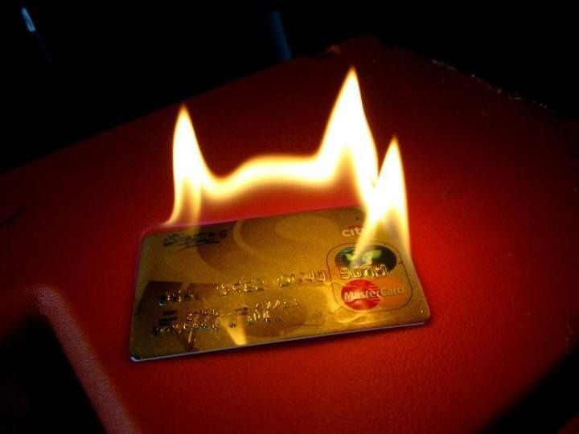
Invest your treasure.
Notes:
Invest your treasure—shown in your giving.
Pray that the things of this world lose their attraction to you so that it’s not hard to part with your money.
Pray that you will give what God wants you to give—not what you want to give!

Slide 67
Prices changed
Notes:
Years ago a boat storeowner opened up his store one morning and discovered that someone had broken into the store overnight. However, nothing was stolen—but all the price tags were switched! A cheap rope was priced at $10,000 and an expensive outboard motor cost only $1.49. A water ski that normally cost $250 was only $7 and a $20,000 boat was now priced at $20!
You think that sounds strange? Years ago an enemy of God broke into our world and switched the values of things even more important. People who are priceless in God’s eyes were reduced to nothing while eternal investments sent to heaven in advance were cheapened through ridicule as a stupid use of money. Yet, all along, God has told us where true value lies—in him, in his Word, and in people made in his image.

Slide 68
Black

Slide 69
NT Sermons link at biblestudydownloads.org
Get this presentation and script for free!

